Slide 1

Analysis of Epidemic Spread Using Mathematical and Computational Models
By Jonah Zembower

Slide 2
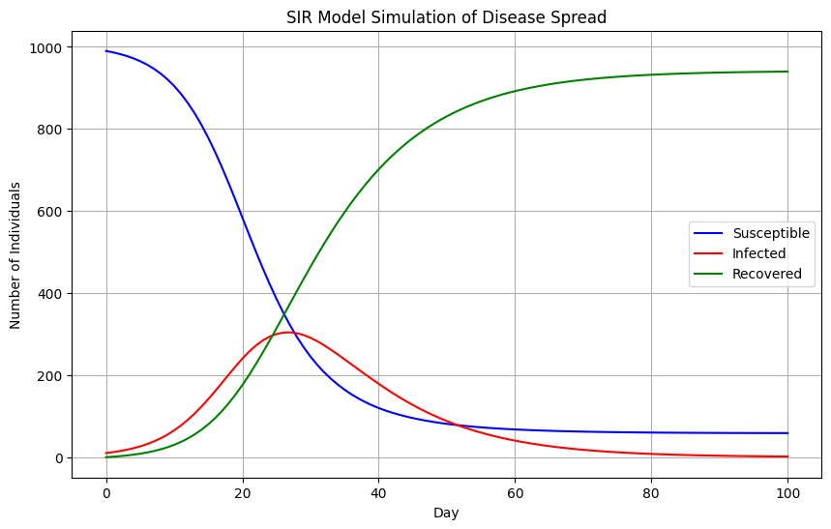
SIR Model Simulation of Disease Spread
Notes:
Here is the plot of the SIR model simulation. This shows the progression of susceptible, infected, and recovered groups over time. The number of susceptible decreases over time as more people get infected. Also, the number of infected individuals initially increases, reaches a peak, and then declines as individuals recover or become immune. Lastly, the recovered count increases steadily, representing people who recover from the infection and are no longer susceptible.

Slide 3
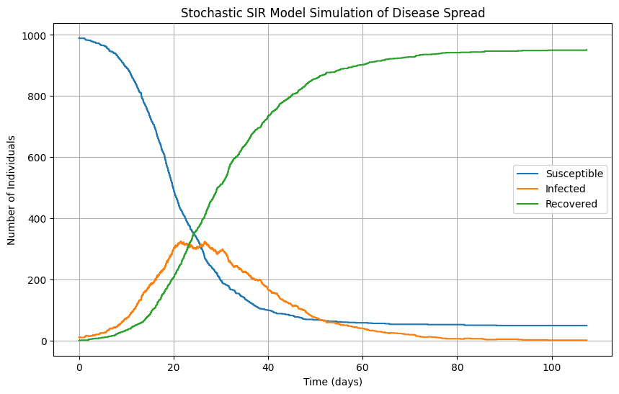
Stochastic SIR Model Simulation of Disease Spread
Notes:
This model includes randomness in the timing and order of infection and recover events, which provides a more nuanced understanding of how disease spread might fluctuate due to stochastic factors in a real-world setting. There is definitely a jagged nature here to the infected curve.

Slide 4
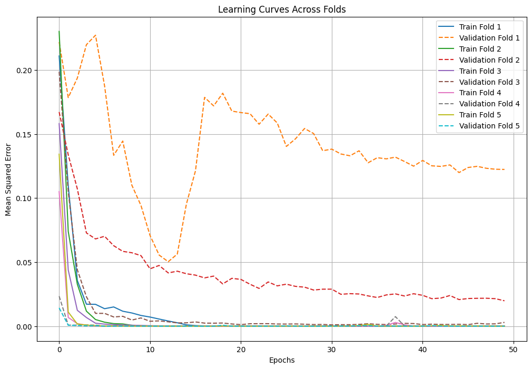
Neural Network

Slide 5
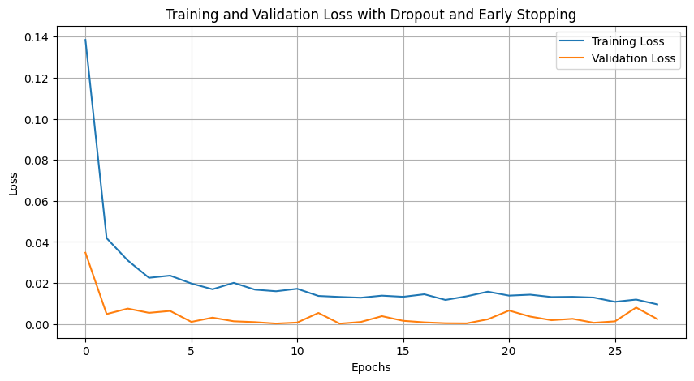

Slide 6
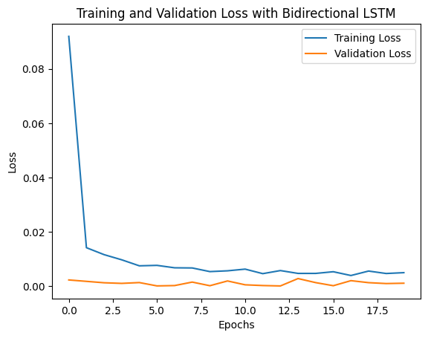
Found to work better with Bidirectional LSTM

Slide 7
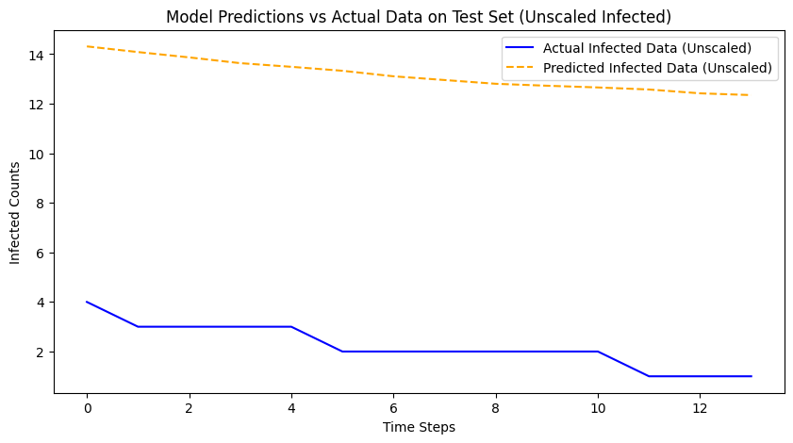
Final Variable Predictions
These predictions change with new runs over time, however, you can see need for general improvement
Mean Squared Error: 120.01606414334957
Mean Absolute Error: 10.94920343000974

Slide 8
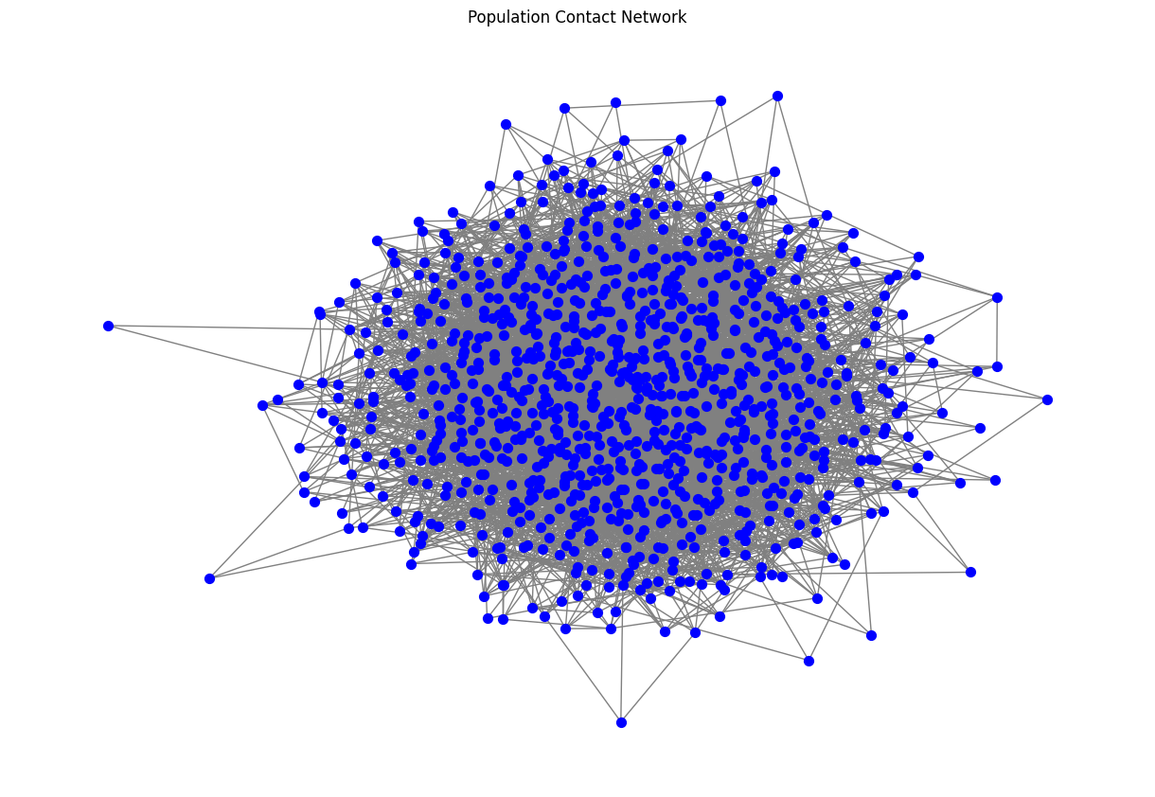
Graph Theory ANalysis
Notes:
This visualization shows the structure of the population contact network. There are 1000 nodes and 4974 edges. The average degree is approximately 9.95, indicating the average number of connections per person. The network density approximately 0.00996, a measure of the overall connectivity of the network.

Slide 9
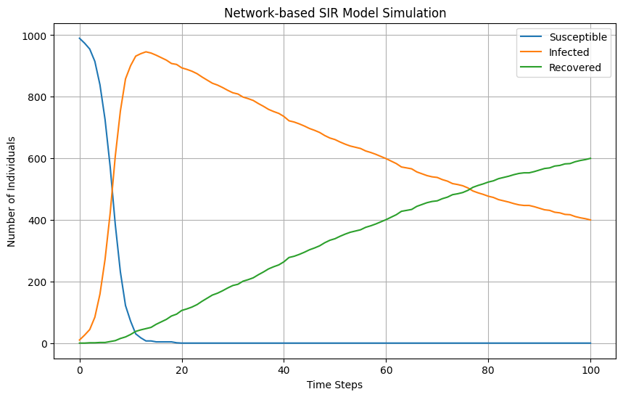
Network Based SIR Model
Notes:
This visualization represents how the disease spreads and resolves within the network over time.

Slide 10
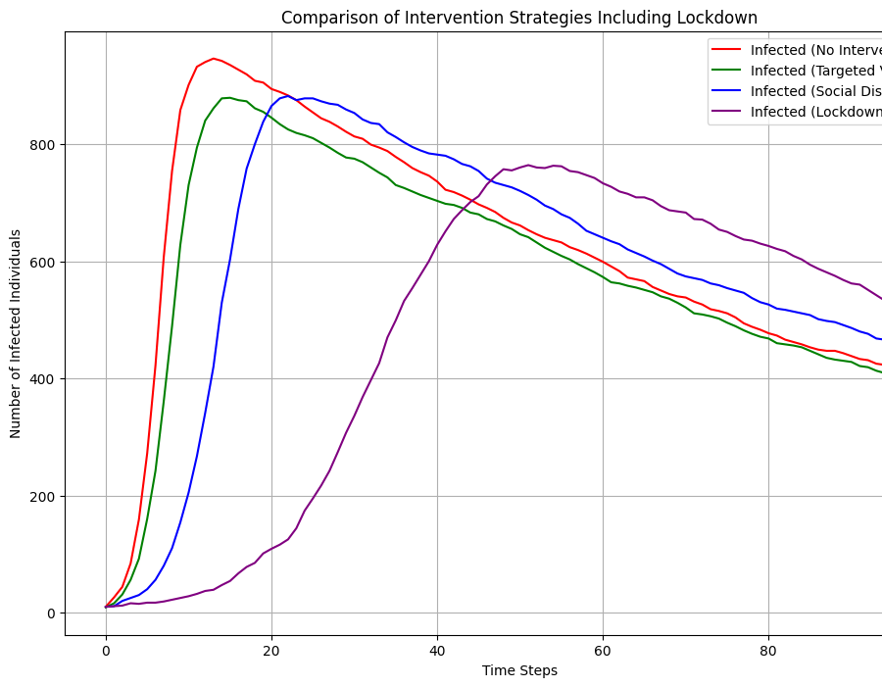
Comparing Intervention Strategies
Notes:
This plot includes the effects of a lockdown intervention, alongside no intervention, targeted vaccination, and social distancing. For the infection, it peaks sharply and then declines as individuals either recover or the disease spreads through available susceptible hosts. There are more things I want to look at in the future over the next day.

